Slide 1
RATINGS PREDICTION PROJECT
Submitted By
Girija Chandra Mohan

Slide 2
INTRODUCTION
This is a Machine Learning Project performed on customer reviews. Reviews are processed using common NLP techniques.
Millions of people use Amazon and Flipkart to buy products. For every product, people can rate and write a review. If a product is good, it gets a positive review and gets a higher star rating, similarly, if a product is bad, it gets a negative review and lower star rating. My aim of this project is to predict star rating automatically based on the product review.
The range of star rating is 1 to 5. That means if the product review is negative, then it will get low star rating (possibly 1 or 2), if the product is average then it will get medium star rating (possibly 3), and if the product is good, then it will get higher star rating (possibly 4 or 5).
This task is similar to Sentiment Analysis, but instead of predicting the positive and negative sentiment (sometimes neutral also), here we need to predict the rating.

Slide 3
MATHEMATICAL/ANALYTICAL MODELLING OF THE PROBLEM
In our scrapped dataset, our target variable "Rating " is a categorical variable i.e., it can be classified as ‘1.0’, ‘2.0’,’3.0’,’4.0’,’5.0’. Therefore, we will be handling this modelling problem as classification.
This project is done in two parts:
Data collection phase
Model Building phase

Slide 4
In Data collection phase, we will scrape nearly 50000 of reviews data from different e-commerce websites like Amazon, Flipkart, etc. and it is collected by using Webscraping and Selenium.
Fetch an equal number of reviews for each rating, for example if you are fetching 10000 reviews then all ratings 1,2,3,4,5 should be 2000. It will balance our data set.
Convert all the ratings to their round number, as there are only 5 options for rating i.e., 1,2,3,4,5. If a rating is 4.5 convert it 5.
After collecting the data, you need to build a machine learning model. Before model building do all data pre-processing steps involving NLP. Try different models with different hyper parameters and select the best model. Follow the complete life cycle of data science. Include all the steps like-
1. Data Cleaning
2. Exploratory Data Analysis
3. Data Pre-processing
4. Model Building
5. Model Evaluation
6. Selecting the best model

Slide 5
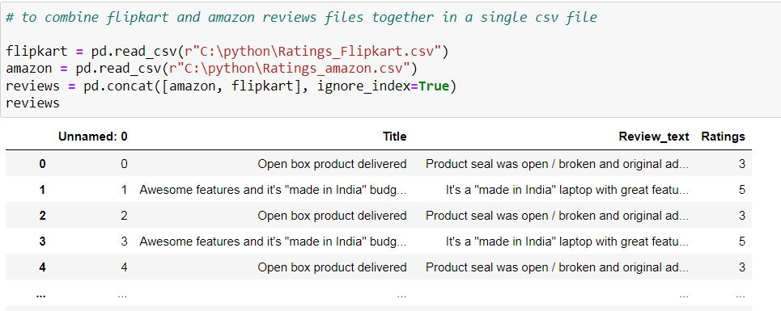
DATA SOURCES AND THEIR FORMATS

Slide 6
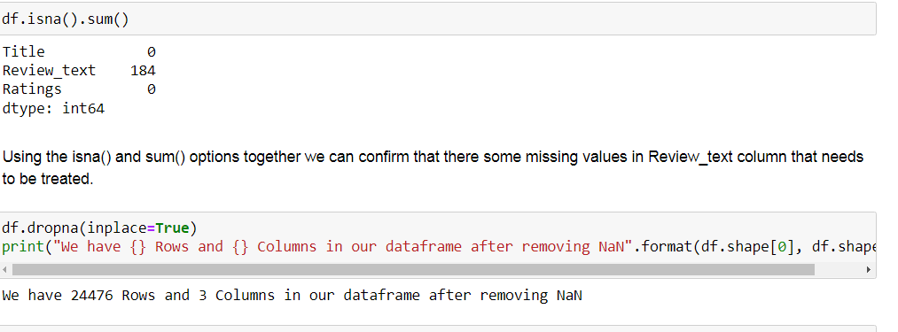
DATA PRE-PROCESSING
Handling missing data using fillna and checking the datatypes

Slide 7
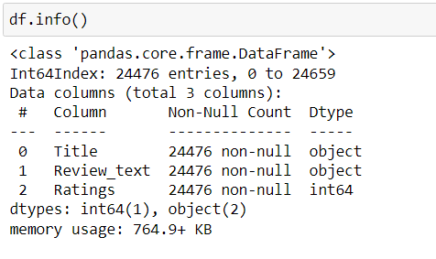
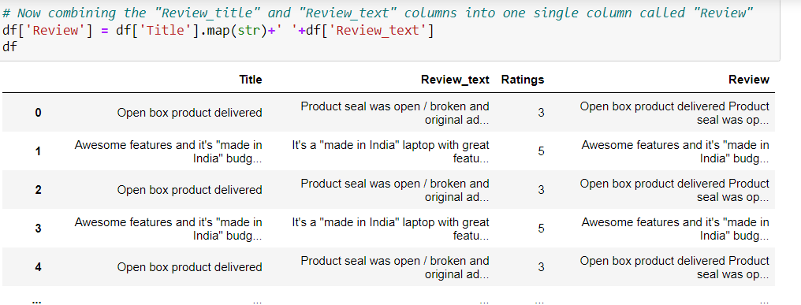
Checking the info of the dataset and combining review text and Title into single column to perform NLP processing.

Slide 8
Pre-processing using Natural Language Processing (NLP):
We cleaned the data using regex, matching patterns in the comments and replacing them with more organized counterparts. Cleaner data leads to a more efficient model and higher accuracy. Following steps are involved:
1. Removing Punctuations and other special characters
2. Splitting the comments into individual words
3. Removing Stop Words
There is a corpus of stop-words, that are high-frequency words such as "the", "to" and "also", and that we sometimes want to litter out of a document before further processing. Stop-words usually have little lexical content, don’t alter the general meaning of a sentence and their presence in a text fails to distinguish it from other texts. We used the one from Natural Language Toolkit a leading platform for building Python programs to work with human language.

Slide 9
We will be tokenizing the data using RegexpTokenizer
Stemming is the process of converting inflected/derived words to their word stem or the root form. Basically, a large number of similar origin words are converted to the same word. E.g., words like "stems", "stemmer", "stemming", "stemmed" as based on "stem". This helps in achieving the training process with a better accuracy.
Lemmatizing is the process of grouping together the inflected forms of a word so they can be analyzed as a single item. This is quite similar to stemming in its working but differs since it depends on correctly identifying the intended part of speech and meaning of a word in a sentence, as well as within the larger context surrounding that sentence, such as neighboring sentences or even an entire document.
Then, we will be processing the review and assigning the updated review in the data frame
Finally, we get sense of words for all ratings using WordCloud. Word Cloud is a data visualization technique used for representing text data in which the size of each word indicates its frequency or importance.

Slide 10
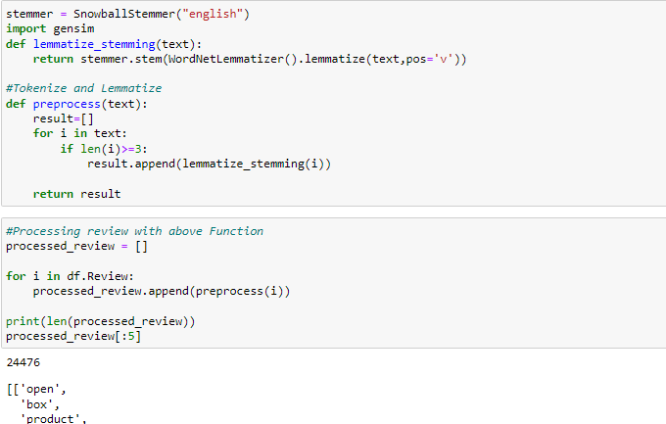

Slide 11
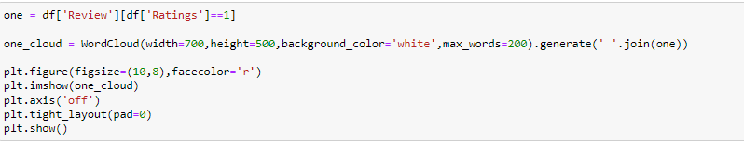
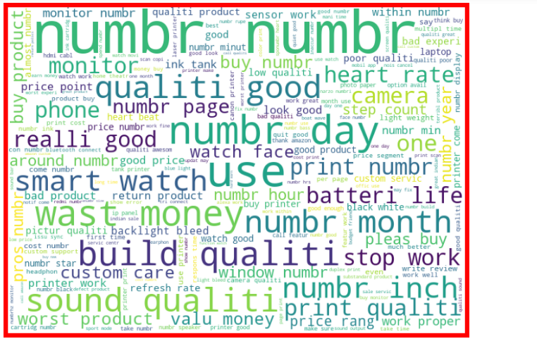
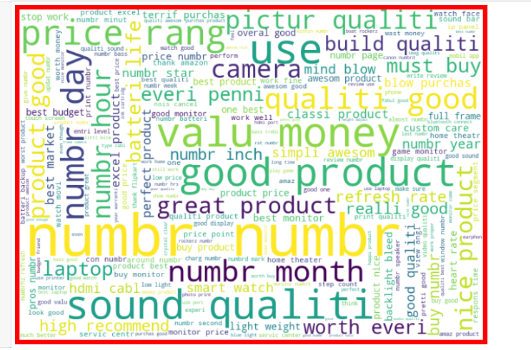

Slide 12
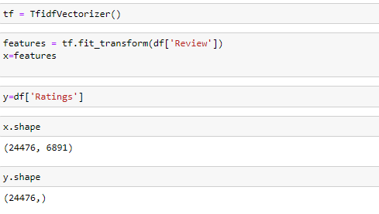
Feature Extraction:
Here we can finally convert our text to numeric using Tf-idf Vectorizer.
Term Frequency Inverse Document Frequency (TF-IDF):
This is very common algorithm to transform text into a meaningful representation of numbers which is used to fit machine algorithm for prediction.

Slide 13
HARDWARE AND SOFTWARE REQUIREMENTS AND TOOLS USED
For doing this project, the hardware used is a laptop with high end specification and a stable internet connection. While coming to software part, I had used anaconda navigator and in that I have used Jupyter notebook to do my python programming and analysis.
For using an CSV file, Microsoft excel is needed. In Jupyter notebook, I had used lots of python libraries to carry out this project and I have mentioned below with proper justification:

Slide 14
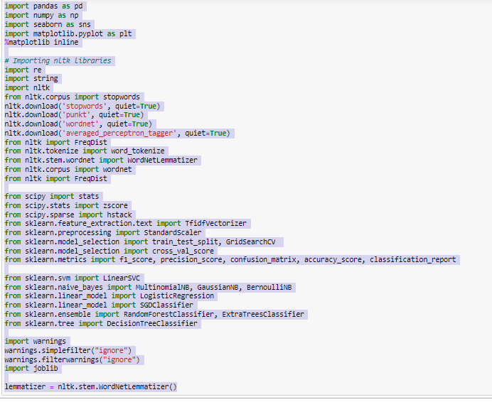
Library Used

Slide 15
MODEL/S DEVELOPMENT AND EVALUATION
Various models used for training are:
MultinomialNB()
DecisionTreeclassifier()
RandomForestClassifier()
KNN()
SVC()
Run and Evaluate selected models
We have used a total of 5 Regression Models after choosing the random state amongst 1-100 number. Then it is checked for best fold for CV using the following codes

Slide 16
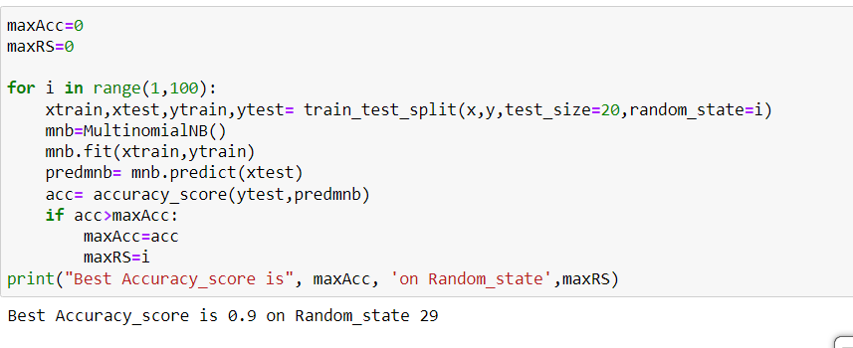

Slide 17
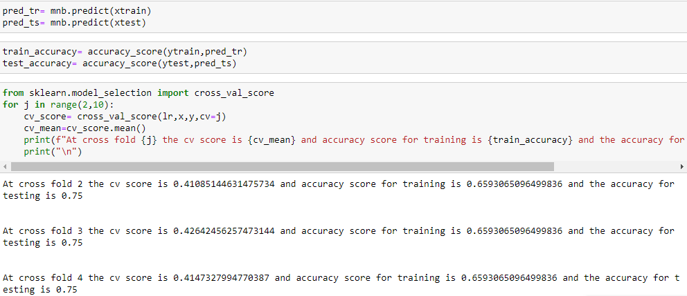

Slide 18
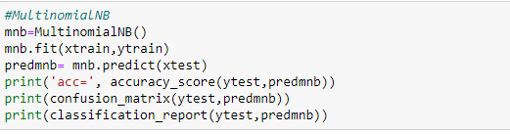
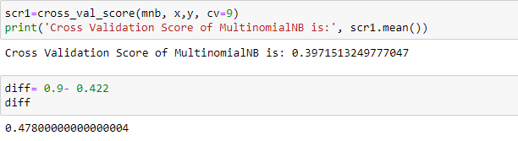
MultinomialNB

Slide 19
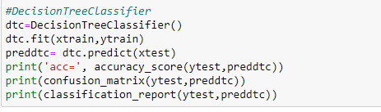
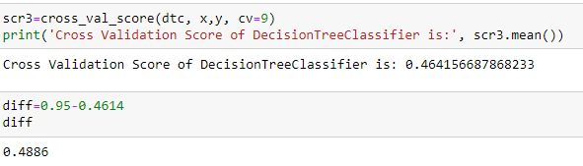
DecisionTreeClassifier

Slide 20
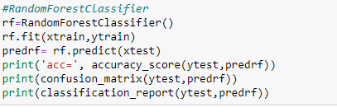
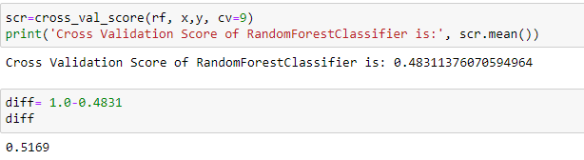
RandomForestClassifier

Slide 21
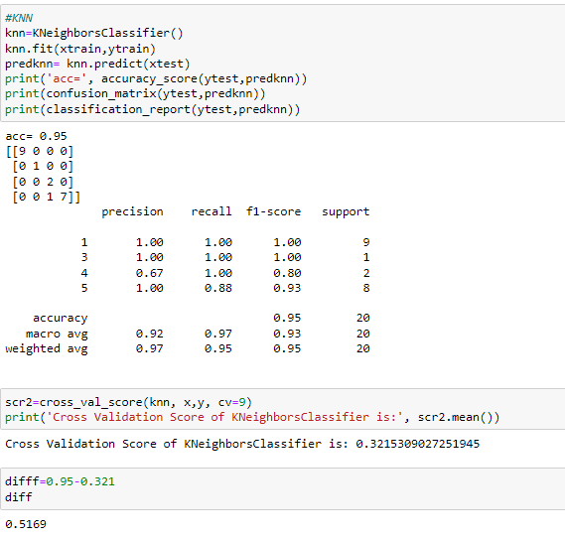
KNN

Slide 22
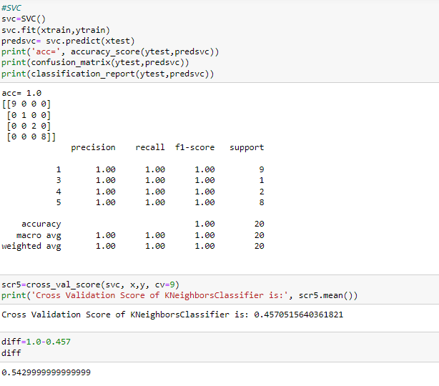
SVC

Slide 23
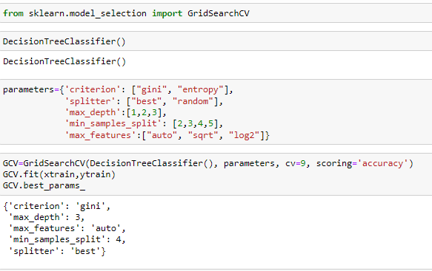
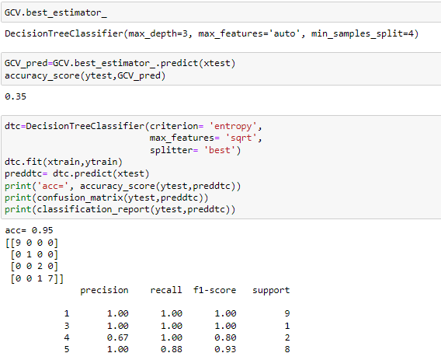
HyperParameter Tuning

Slide 24
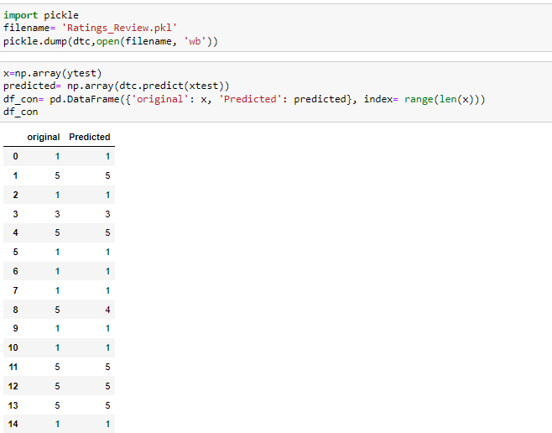
After applying Hyperparameter Tuning, we can see that DecisionTreeClassifier Algorithm is performing well as the scores are improved, i.e., accuracy score from 90 to 95 Now, we will finalize DecisionTreeClassifier algorithm model as the final model.
FINAL MODEL

Slide 25
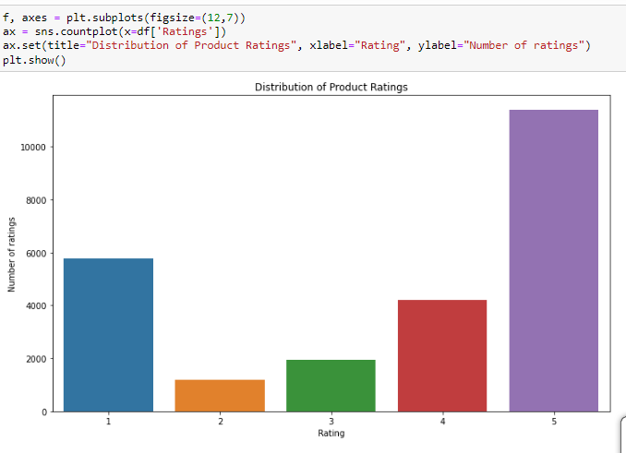
DATA VISUALIZATION

Slide 26
CONCLUSION
After the completion of this project, we got an insight of how to collect data, pre-processing the data, analysing the data and building a model.
First, we collected the reviews and ratings data from different e-commerce websites like Amazon and Flipkart and it was done by using Webscraping. The framework used for webscraping was Selenium, which has an advantage of automating our process of collecting data.
We collected almost 25000 of data which contained the ratings from 1.0 to 5.0 and their reviews.
Then, the scrapped data was combined in a single dataframe and saved in a csv file so that we can open it and analyze the data.

Slide 27
We did the pre-processing using NLP and the steps are as follows:
Removing Punctuations and other special characters
Splitting the comments into individual words
Removing Stop Words
Stemming and Lemmatising
Applying Count Vectorizer
Splitting dataset into Training and Testing
After separating our train and test data, we started running different machine learning classification algorithms to find out the best performing model.
We found that RandomForest and GradientBoosting Algorithms were performing well, according to their accuracy and cross val scores.
Then, we performed Hyperparameter Tuning techniques using GridSearchCV for getting the best parameters and improving the scores. In that, RandomForestClassifier performed well and we finalised that model.
We saved the model in pkl format and then saved the predicted values in a csv format.

Slide 28
The problems we faced during this project were:
More time consumption during hyperparameter tuning for both models, as the data was large.
Less number of parameters were used during tuning.
Scrapping of data from different websites were of different process and the length of data were differing in most cases.
Some of the reviews were bad and the text had more wrong information about the product.
WordCloud was not showing proper text which had more positive and negative weightage.
Areas of improvement:
Less time complexity
More computational power can be given
Errors can be avoided.

Slide 29
Thank You

